Slide 1


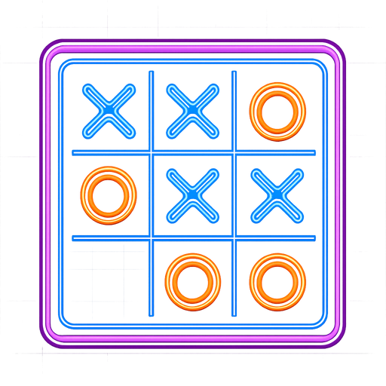


TACTIX
Presented by : Team ByteBotes

Slide 2
TEAM MEMBER
Md.All Shahariar SHakib (0112330360)
Sadeed S'aad Zaman Shefin(0112330362)
Foyshal Hossain Jihad (0112230351)
Kazi Towsif Jawad (011172007)

Slide 3




INTRODUCTION
Tic Tac Toe is a classic two-player turn-based game.
TOPIC
This project implements the game using Python.
An AI agent will compete against a human player.
This project focuses on developing an AI-based opponent.
The AI will make intelligent decisions instead of random moves.

Slide 4

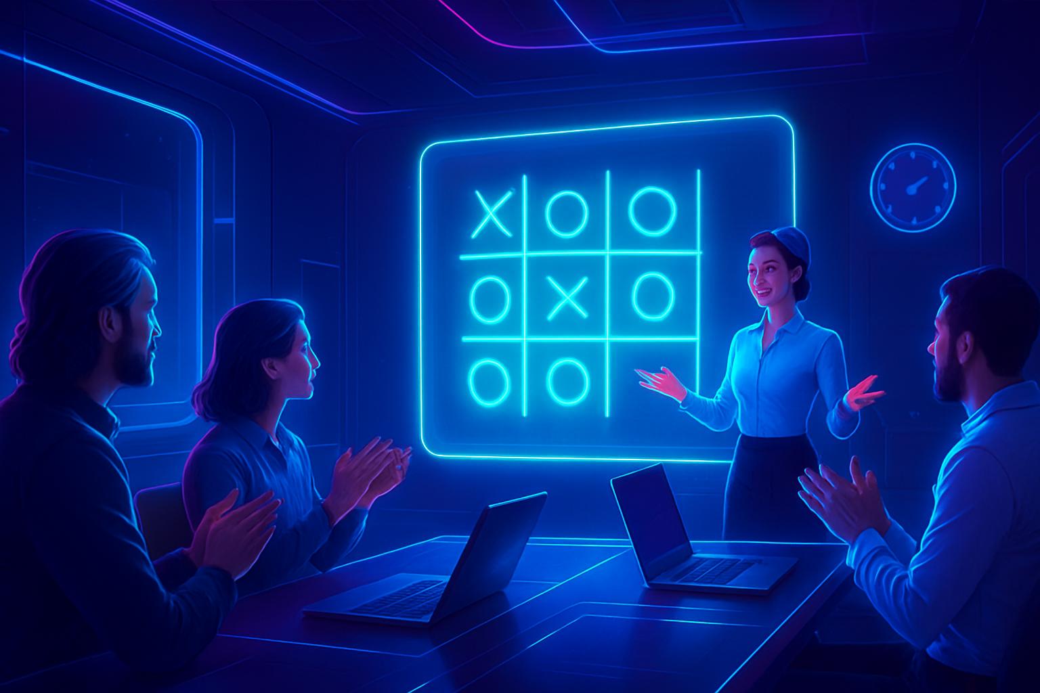



PROBLEM STATEMENT
Traditional Tic Tac Toe games lack intelligent opponents.
Players quickly lose interest when the game becomes predictable.
The challenge is to design an AI that plays optimally.

Slide 5

PROJECT GOALS
Goal 1
Goal 2
Goal 3
Use the Minimax algorithm for decision making.
Evaluate game states using a utility function.
Ensure Correct Game Logic and Rules

Slide 6



METHODOLOGY
Game Representation
State Space Definition
Move Generation
The Tic Tac Toe board will be represented using appropriate Python data structures (such as a 3×3 list or array), where each cell indicates an empty position, a human1 move (X), or an Opponent (O).
All possible game states will be defined based on the current board configuration. Each state represents a unique arrangement of moves made by the players.
At each turn, the system will generate all possible valid moves by identifying empty positions on the board.

Slide 7
PROCESS
Phase 1
Phase 3
Requirement Analysis
System Design
Identify project requirements, including game rules, player interaction, AI behavior, and system constraints based on course objectives.
Design the overall structure of the game, including board layout, turn management, and interaction between the human player and AI agent.
Phase 2
Phase 4
Game Board Implementation
Rule and Logic Development
Implement the Tic Tac Toe board using Python data structures and define symbols for human and AI players.
Develop logic for validating moves, switching turns, detecting win conditions, and handling draw scenarios.

Slide 8
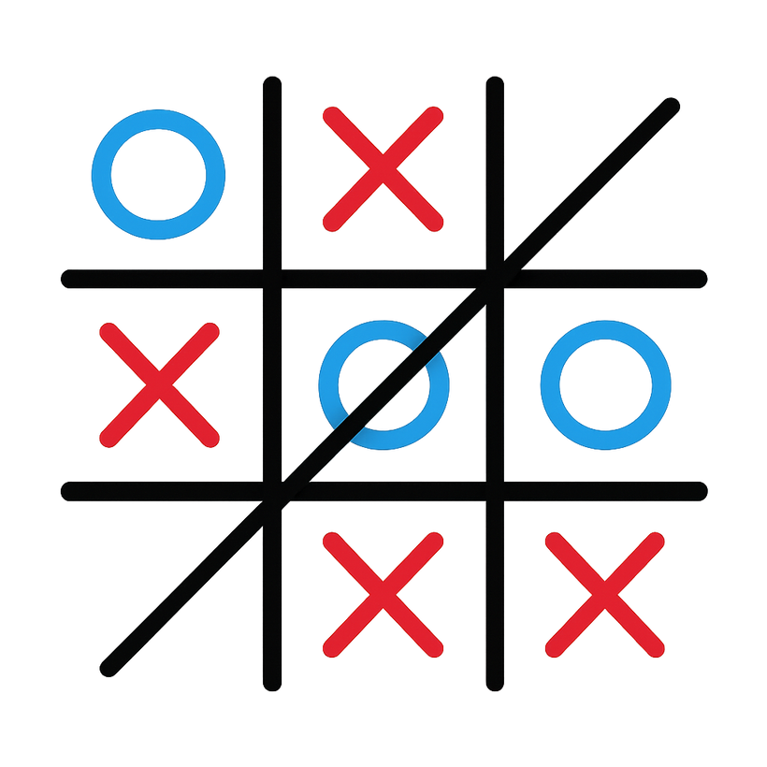
RESULT
Working Python Tic Tac Toe game
Strategic computer opponent
Correct win and draw detection
Smooth and reliable performance
Well-structured and maintainable code

Slide 9

CONCLUSION
This project successfully demonstrates the development of a Tic Tac Toe game using Python with a structured and logical approach. The system allows a human player to compete against a computer-controlled opponent while correctly following all game rules and conditions.
Through this project, key concepts such as problem analysis, algorithmic decision-making, and program design are applied in a practical context. The implementation highlights how logical strategies can be used to create an engaging and reliable game system.
Overall, the project meets its objectives and provides a solid foundation for future enhancements, such as adding a graphical interface, multiple difficulty levels, or additional game features. The project is well-suited for academic purposes and effectively demonstrates problem-solving and programming skills.

Slide 10
THANK YOU!

